Slide 1
PROJECT ON
MESSENGER
SUBMITTTED BY :-
RITURAJ BHARTI
ASHWINI RAMDAS KALSKAR
PRAVEEN KUMAR
GORANTLA INDIRA
ABHITOSH KUMAR
CHANDAN
UNDER THE GUIDENCE OF
SHILPAVAIDYA
(TRAINER)

Slide 2

MESSENGER
APPLICATION

Slide 3
CONTENTS
INTRODUCTION
objective
Database er model
Tables
SQL QUERIES
REFERNCES

Slide 4
INTRODUCTION
Database is a collection of inter-related data which helps in efficient retrieval, insertion and deletion of data from database and organizes the data in the form of tables, views, schemas, reports etc.
For Example, university database organizes the data about students, faculty, and admin staff etc. which helps in efficient retrieval, insertion and deletion of data from it.
A collected information which is in an organized form for easier access, management, and various updating is known as a database.

Slide 5
Objective
The main objective of this project is easy to communicate with anyone.
A messenger app is any app that enables a private messaging function between two or more people.
Messenger is a FREE mobile messaging app used for instant messaging, sharing photos, videos, audio recordings and for group chats.
The app, which is free to download, can be used to communicate with your friends on Facebook and with your phone contacts.

Slide 6
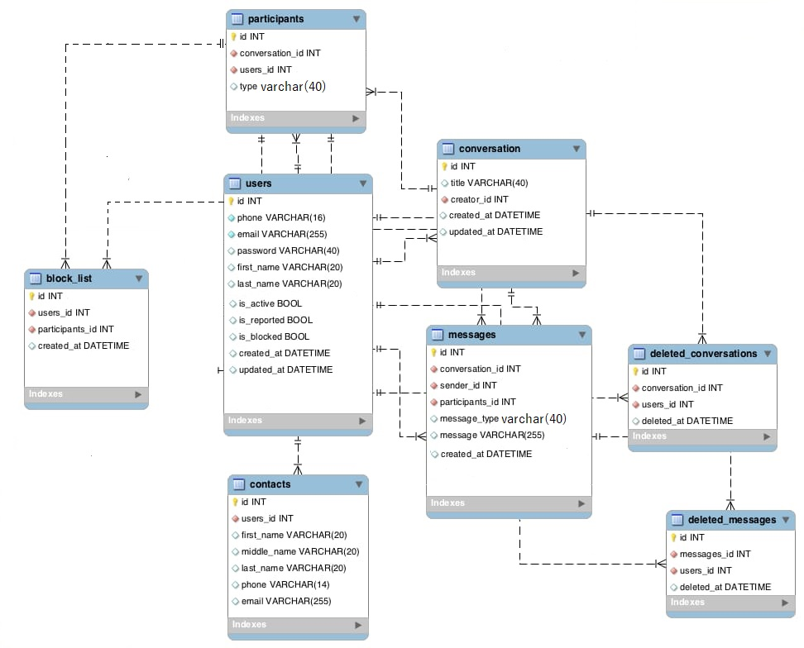
USER DAIGRAM

Slide 7
ER model
An entity relationship diagram (ERD) shows the relationships of entity sets stored in a database
ER diagrams illustrate the logical structure of databases

Slide 8
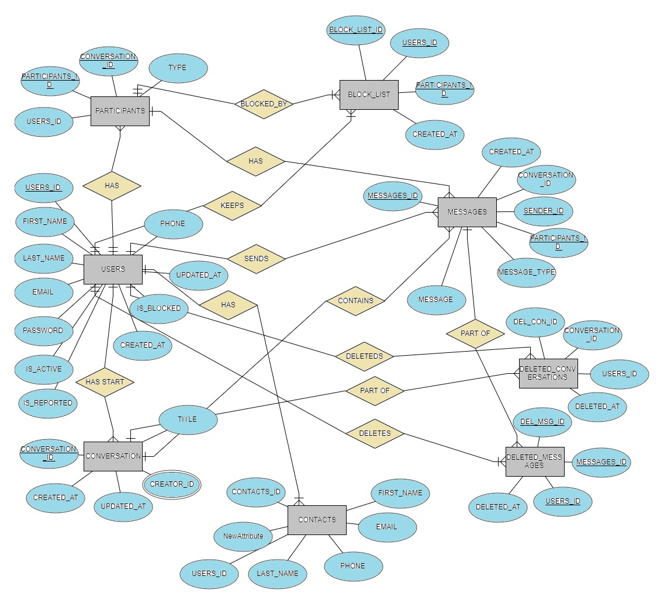
Messenger Database ER Model:

Slide 9
USERS
USERS_ID INT PRIMARY KEY,
FIRST_NAME VARCHAR(20),
LAST_NAME VARCHAR(20),
EMAIL VARCHAR(225),
PASSWORD VARCHAR(6),
PHONE VARCHAR(16),
IS_ACTIVE BIT,
IS_REPORTED BIT,
IS_BLOCKED BIT,
CREATED_AT DATETIME,
UPDATED_AT DATETIME

Slide 10
CONTACTS
CONTACTS_ID INT PRIMARY KEY,
USERS_ID INT FOREIGN KEY REFERENCES USERS(USERS_ID),
FIRST_NAME VARCHAR(20),
LAST_NAME VARCHAR(20),
PHONE VARCHAR(14),
EMAIL VARCHAR(225)

Slide 11
PARTICIPANTS
PARTICIPANTS_ID INT PRIMARY KEY,
CONVERSATION_ID INT FOREIGN KEY REFERENCES CONVERSATION(CONVERSATION_ID),
USERS_ID INT FOREIGN KEY REFERENCES USERS(USERS_ID),
TYPE VARCHAR(100)

Slide 12
CONVERSATION
CONVERSATION_ID INT PRIMARY KEY,
TITLE VARCHAR(40),
CREATOR_ID INT FOREIGN KEY REFERENCES USERS(USERS_ID),
CREATED_AT DATETIME,
UPDATED_AT DATETIME

Slide 13
MESSAGES
MESSAGES_ID INT PRIMARY KEY,
CONVERSATION_ID INT FOREIGN KEY REFERENCES CONVERSATION(CONVERSATION_ID),
SENDER_ID INT FOREIGN KEY REFERENCES USERS(USERS_ID),
PARTICIPANTS_ID INT FOREIGN KEY REFERENCES PARTICIPANTS(PARTICIPANTS_ID),
MESSAGE_TYPE VARCHAR(45),
MESSAGE VARCHAR(225),
CREATED_AT DATETIME

Slide 14
DELETED_CONVERSATIONS
DEL_CON_ID INT PRIMARY KEY,
CONVERSATION_ID INT FOREIGN KEY REFERENCES CONVERSATION(CONVERSATION_ID),
USERS_ID INT FOREIGN KEY REFERENCES USERS(USERS_ID),
DELETED_AT DATETIME

Slide 15
DELETED_MESSAGES
DEL_MSG_ID INT PRIMARY KEY,
MESSAGES_ID INT FOREIGN KEY REFERENCES MESSAGES(MESSAGES_ID),
USERS_ID INT FOREIGN KEY REFERENCES USERS(USERS_ID),
DELETED_AT DATETIME

Slide 16
BLOCK_LIST
BLOCK_LIST_ID INT PRIMARY KEY,
USERS_ID INT FOREIGN KEY REFERENCES USERS(USERS_ID),
PARTICIPANTS_ID INT FOREIGN KEY REFERENCES PARTICIPANTS(PARTICIPANTS_ID),
CREATED_AT DATETIME

Slide 17
INSERTION OF DATA IN TABLES

Slide 18
Data Insertion In Users Table
INSERT INTO USERS VALUES(1,'RITURAJ','BHARTI','RITURAJ@GMAIL.COM','RTJ123','8765347486',1,0,0,'06-05-2012 09:23:02','08-06-2020 02:43:32');
INSERT INTO USERS VALUES(2,'ABHITOSH','KUMAR','ABHITOSH@GMAIL.COM','ABH123','9836465263',1,1,0,'08-04-2011 02:23:02','02-06-2021 08:45:00');
INSERT INTO USERS VALUES(3,'CHANDAN','KUMAR','CHANDAN@GMAIL.COM','CHD123','8736474888',1,0,0,'12-05-2012 01:23:02','12-01-2021 19:12:00');
INSERT INTO USERS VALUES(4,'PRAVEEN','KUMAR','PRAVEEN@GMAIL.COM','PRV123','7646748488',1,1,0,'02-15-2012 12:23:02','02-03-2021 21:13:52');
INSERT INTO USERS VALUES(5,'INDIRA','SINGH','INDIRA@GMAIL.COM','IDR123','8787453446',1,0,0,'08-13-2014 19:22:12','03-17-2021 03:03:12');
INSERT INTO USERS VALUES(6,'ASHWINI','SHARMA','ASHWINI@GMAIL.COM','ASH123','8765347486',1,1,0,'04-14-2012 13:23:00','02-12-2020 04:27:32');
INSERT INTO USERS VALUES(7,'RAHUL','RAJ','RAJ@GMAIL.COM','RAJ123','7763647488',1,0,1,'07-05-2015 22:13:02','08-13-2020 13:03:00');
INSERT INTO USERS VALUES(8,'MUKESH','SAHU','MUKESH@GMAIL.COM','MSH123','9837466373',1,1,0,'07-14-2013 16:43:14','11-02-2021 03:20:09');
INSERT INTO USERS VALUES(9,'RAKESH','SHARMA','RAKESH@GMAIL.COM','RSH123','9345447488',1,0,1,'07-15-2013 23:22:22','06-13-2020 08:26:00');
INSERT INTO USERS VALUES(10,'SAHIL','KHAN','SAHIL@GMAIL.COM','SHL123','9837447744',1,1,0,'06-14-2012 16:53:02','03-17-2021 09:21:08');

Slide 19
Data Insertion In Contacts Table
INSERT INTO CONTACTS VALUES(111,1,'RITURAJ','BHARTI','8765347486','RITURAJ@GMAIL.COM');
INSERT INTO CONTACTS VALUES(222,2,'ABHITOSH','KUMAR','9836465263','ABHITOSH@GMAIL.COM');
INSERT INTO CONTACTS VALUES(333,3,'CHANDAN','KUMAR','8736474888','CHANDAN@GMAIL.COM');
INSERT INTO CONTACTS VALUES(444,4,'PRAVEEN','KUMAR','7646748488','PRAVEEN@GMAIL.COM');
INSERT INTO CONTACTS VALUES(555,5,'INDIRA','SINGH','8787453446','INDIRA@GMAIL.COM');
INSERT INTO CONTACTS VALUES(666,6,'ASHWINI','SHARMA','8765347486','ASHWINI@GMAIL.COM');
INSERT INTO CONTACTS VALUES(777,7,'RAHUL','RAJ','7763647488','RAJ@GMAIL.COM');
INSERT INTO CONTACTS VALUES(888,8,'MUKESH','SAHU','9837466373','MUKESH@GMAIL.COM');
INSERT INTO CONTACTS VALUES(999,9,'RAKESH','SHARMA','9345447488','RAKESH@GMAIL.COM’);
INSERT INTO CONTACTS VALUES(1000,10,'SAHIL','KHAN','9837447744','SAHIL@GMAIL.COM');

Slide 20
Data Insertion in Participants Table
INSERT INTO PARTICIPANTS VALUES(2001,1001,1,'SINGLE');
INSERT INTO PARTICIPANTS VALUES(2002,1002,2,'GROUP');
INSERT INTO PARTICIPANTS VALUES(2003,1003,3,'SINGLE');
INSERT INTO PARTICIPANTS VALUES(2004,1004,4,'GROUP');
INSERT INTO PARTICIPANTS VALUES(2005,1005,5,'SINGLE');
INSERT INTO PARTICIPANTS VALUES(2006,1006,6,'GROUP');
INSERT INTO PARTICIPANTS VALUES(2007,1007,7,'SINGLE');
INSERT INTO PARTICIPANTS VALUES(2008,1008,8,'SINGLE');
INSERT INTO PARTICIPANTS VALUES(2009,1009,9,'GROUP');
INSERT INTO PARTICIPANTS VALUES(2010,1010,10,'GROUP');

Slide 21
Data Insertion In Conversation Table
INSERT INTO CONVERSATION VALUES(1001,'BHARTI',1,'06-05-2012 09:23:02','08-06-2020 02:43:32');
INSERT INTO CONVERSATION VALUES(1002,'ABHIK',2,'8-04-2011 02:23:02','02-06-2021 08:45:00');
INSERT INTO CONVERSATION VALUES(1003,'KUMAR_C',3,'12-05-2012 01:23:02','12-01-2021 19:12:00');
INSERT INTO CONVERSATION VALUES(1004,'PRAVEEN578',4,'02-15-2012 12:23:02','02-03-2021 21:13:52');
INSERT INTO CONVERSATION VALUES(1005,'SINGH_INDU',5,'08-13-2014 19:22:12','03-17-2021 03:03:12');
INSERT INTO CONVERSATION VALUES(1006,'ASH123',6,'04-14-2012 13:23:00','02-12-2020 04:27:32');
INSERT INTO CONVERSATION VALUES(1007,'RAJ_RAHUL',7,'07-05-2015 22:13:02','08-13-2020 13:03:00');
INSERT INTO CONVERSATION VALUES(1008,'SAHU_MUKESH',8,'07-14-2013 16:43:14','11-02-2021 03:20:09');
INSERT INTO CONVERSATION VALUES(1009,'RAKESH958',9,'07-15-2013 23:22:22','06-13-2020 08:26:00');
INSERT INTO CONVERSATION VALUES(1010,'KHAN_SAHIL',10,'06-14-2012 16:53:02','03-17-2021 09:21:08');

Slide 22
Data Insertion In Messages Table
INSERT INTO MESSAGES VALUES(3001,1001,1,2001,'SINGLE','Hello, Good Morning','06-05-2012 02:12:35');
INSERT INTO MESSAGES VALUES(3002,1002,2,2002,'SINGLE','Hello, What was the trip?','08-04-2011 02:09:00');
INSERT INTO MESSAGES VALUES(3003,1003,3,2003,'SINGLE','Hello, Have u visited Delhi?','12-05-2012 11:09:10');
INSERT INTO MESSAGES VALUES(3004,1004,4,2004,'SINGLE','Hello,Whats going on?','02-15-2012 03:23:48');
INSERT INTO MESSAGES VALUES(3005,1005,5,2005,'SINGLE','Hii, Where r u from?','08-13-2014 22:09:32');
INSERT INTO MESSAGES VALUES(3006,1006,6,2006,'SINGLE','Hello, I am good','04-14-2012 23:12:14');
INSERT INTO MESSAGES VALUES(3007,1007,7,2007,'SINGLE','Hello, What Happend?','07-05-2015 22:11:33');
INSERT INTO MESSAGES VALUES(3008,1008,8,2008,'SINGLE','Hello, How r u?','07-14-2013 21:46:32');
INSERT INTO MESSAGES VALUES(3009,1009,9,2009,'SINGLE','Hello brother..!!','07-15-2013 07:35:32');
INSERT INTO MESSAGES VALUES(3010,1010,10,2010,'SINGLE','Hello..!','06-14-2012 12:23:12');

Slide 23
Data Insertion In Deleted _Conversations Table
INSERT INTO DELETED_CONVERSATIONS VALUES(4001,1001,1,'08-13-2020 22:09:32');
INSERT INTO DELETED_CONVERSATIONS VALUES(4002,1002,2,'07-05-2019 22:11:33')
INSERT INTO DELETED_CONVERSATIONS VALUES(4003,1003,3,'06-11-2021 12:23:12');
INSERT INTO DELETED_CONVERSATIONS VALUES(4004,1004,4,'12-05-2021 11:09:10');
INSERT INTO DELETED_CONVERSATIONS VALUES(4005,1005,5,'06-05-2020 02:12:35');

Slide 24
Data Insertion In Deleted _Messages Table
INSERT INTO DELETED_MESSAGES VALUES(5001,3001,1,'08-13-2020 22:09:32');
INSERT INTO DELETED_MESSAGES VALUES(5002,3002,2,'06-14-2019 12:23:12');
INSERT INTO DELETED_MESSAGES VALUES(5003,3003,3,'06-05-2018 02:12:35');
INSERT INTO DELETED_MESSAGES VALUES(5004,3004,4,'07-05-2020 22:11:33');
INSERT INTO DELETED_MESSAGES VALUES(5005,3005,5,'12-05-2017 11:09:10');

Slide 25
Data Insertion In Block_List Table
INSERT INTO BLOCK_LIST VALUES(6001,10,2001,'12-05-2021 11:09:10');
INSERT INTO BLOCK_LIST VALUES(6002,2,2002, '06-05-2018 02:12:35');
INSERT INTO BLOCK_LIST VALUES(6003,3,2003, '08-12-2019 22:09:32');
INSERT INTO BLOCK_LIST VALUES(6004,4,2004, '06-12-2021 12:23:12');
INSERT INTO BLOCK_LIST VALUES(6005,5,2005, '11-11-2020 12:23:12');

Slide 26
SQL QUERIES

Slide 27
Queries By Ashwini kalasakar
1.DISPLAY THE USERS ID, FIRST NAME, LAST NAME, EMAIL, PHONE AND BLOCK LIST ID WHO WAS BLOCKED AFTER 2020-10-11
SELECT U.USERS_ID, U.FIRST_NAME, U.LAST_NAME, U.EMAIL, U.PHONE, B.BLOCK_LIST_ID
FROM USERS U INNER JOIN BLOCK_LIST B
ON U.USERS_ID = B.USERS_ID AND
B.CREATED_AT > '2020-10-11’;
Output:
USERS_ID FIRST_NAME LAST_NAME EMAIL PHONE BLOCK_LIST_ID
10 SAHIL KHAN SAHIL@GMAIL.COM 9837447744 6001
4 PRAVEEN KUMAR PRAVEEN@GMAIL.COM 7646748488 6004
5 INDIRA SINGH INDIRA@GMAIL.COM 8787453446 6005

Slide 28
2.DISPLAY THE USERS ID FIRST NAME, LAST NAME, EMAIL, PHONE WHOSE MESSAGES WERE DELETED ON THE DATE '2020-08-13 22:09:32.000'
SELECT U.USERS_ID, U.FIRST_NAME, U.LAST_NAME, U.EMAIL, U.PHONE
FROM USERS U, DELETED_MESSAGES M
WHERE U.USERS_ID = M.USERS_ID AND M.DELETED_AT ='2020-08-13 22:09:32.000';
Output:
USERS_ID FIRST_NAME LAST_NAME EMAIL PHONE
1 RITURAJ BHARTI RITURAJ@GMAIL.COM 8765347486
3.DISPLAY THE MESSAGE ID AND MESSAGE OF THE USER WHOSE FIRST NAME STARTS WITH ‘A’
SELECT M.MESSAGE
FROM USERS U, MESSAGES M
WHERE U.USERS_ID = M.SENDER_ID AND U.FIRST_NAME LIKE 'S%';
Output:
MESSAGES_ID MESSAGE
3002 Hello, What was the trip?
3006 Hello, I am good

Slide 29
4.DISPLAY THE DETAILS OF USERS WHOSE MESSAGES ARE DELETED AND THE USER IS BLOCKED ORDER BY THEIR FIRST NAMES
SELECT U.USERS_ID, U.FIRST_NAME, U.LAST_NAME, U.EMAIL, U.PHONE, B.BLOCK_LIST_ID
FROM USERS U, DELETED_MESSAGES D, BLOCK_LIST B
WHERE U.USERS_ID = D.USERS_ID AND B.USERS_ID = D.USERS_ID
ORDER BY U.FIRST_NAME;
Output:
USERS_ID FIRST_NAME LAST_NAME EMAIL PHONE BLOCK_LIST_ID
2 ABHITOSH KUMAR ABHITOSH@GMAIL.COM 9836465263 6002
3 CHANDAN KUMAR CHANDAN@GMAIL.COM 8736474888 6003
5 INDIRA SINGH INDIRA@GMAIL.COM 8787453446 6005
4 PRAVEEN KUMAR PRAVEEN@GMAIL.COM 7646748488 6004

Slide 30
5.DISPLAY THE NO OF PARTICIPANTS WHO WERE IN GROUP CONVERSATION AND THEY ARE BLOCKED NOW
SELECT COUNT(P.PARTICIPANTS_ID) AS NO_OF_PARTICIPANTS
FROM PARTICIPANTS P, BLOCK_LIST B
WHERE P.PARTICIPANTS_ID = B.PARTICIPANTS_ID AND P.TYPE ='GROUP’;
Output:
NO_OF_PARTICIPANTS
2

Slide 31
Queries By Chandan
1.QUERY TO DISPLAY USER ID, USER FIRST NAME,USER LAST NAME CONTACT ID AND PHONE USER CREATED BETWEEN 2012-06-05 AND 2015-07-05 AND SORT THE DATA BASED ON USER FIRST NAME IN ASCENDING ORDER USING INNER JOIN
SELECT U.USERS_ID,U.FIRST_NAME,U.LAST_NAME,C.CONTACTS_ID,C.PHONE
FROM USERS U
INNER JOIN CONTACTS C ON U.USERS_ID=C.USERS_ID
WHERE CREATED_AT BETWEEN '2012-06-05' AND '2015-07-05'
ORDER BY FIRST_NAME ASC;
Output:
USERS_ID FIRST_NAME LAST_NAME CONTACTS_ID PHONE
3 CHANDAN KUMAR 333 8736474888
5 INDIRA SINGH 555 8787453446
8 MUKESH SAHU 888 9837466373
9 RAKESH SHARMA 999 9345447488
1 RITURAJ BHARTI 111 8765347486
10 SAHIL KHAN 1000 9837447744

Slide 32
2.QUERY TO DISPLAY USERID, USER FIRST NAME,DELETED CONVERSATION ID, DELETED CONVERSATION TIME, DELTED MESSAGE ID, DELETED MESSAGE TIME AND SORT THE DATA BASED ON USER FIRST NAME DESCENDING ORDER
SELECT U.USERS_ID,U.FIRST_NAME,D1.DEL_CON_ID,D2.DEL_MSG_ID,D1.DELETED_AT
FROM USERS U,DELETED_CONVERSATIONS D1,DELETED_MESSAGES D2
WHERE U.USERS_ID=D1.USERS_ID AND U.USERS_ID=D2.USERS_ID
ORDER BY FIRST_NAME DESC;
USERS_ID FIRST_NAME DEL_CON_ID DEL_MSG_ID DELETED_AT
1 RITURAJ 4001 5001 2020-08-13 22:09:32.000
4 PRAVEEN 4004 5004 2021-12-05 11:09:10.000
5 INDIRA 4005 5005 2020-06-05 02:12:35.000
3 CHANDAN 4003 5003 2021-06-11 12:23:12.000
2 ABHITOSH 4002 5002 2019-07-05 22:11:33.000

Slide 33
3.QUERY TO DISPLAY USERID FIRST NAME CONTACTID EMAIL WHOSE FIRST NAME ENDS WITH H AND USER IS NOT BLOCKED USING INNER JOIN
SELECT U.USERS_ID,U.FIRST_NAME,C.CONTACTS_ID,C.EMAIL
FROM USERS U
LEFT JOIN CONTACTS C ON U.USERS_ID=C.USERS_ID
WHERE U.FIRST_NAME LIKE '%H' AND IS_BLOCKED=0;
Output:
USERS_ID FIRST_NAME CONTACTS_ID EMAIL
2 ABHITOSH 222 ABHITOSH@GMAIL.COM
8 MUKESH 888 MUKESH@GMAIL.COM
4.QUERY TO DISPLAY USER ID, FIRST NAME,CONVERSATION ID,MESSAGE ID AND MESSAGE WHERE MESSAGE CREATED BETWEEN ‘2012-06-05’ AND ‘2014-08-13’
SELECT U.FIRST_NAME,M.CONVERSATION_ID,M.MESSAGES_ID,M.MESSAGE
FROM USERS U, MESSAGES M
WHERE U.USERS_ID = M.SENDER_ID AND M.CREATED_AT BETWEEN '2012-06-05' AND '2014-08-13’;
Output:
FIRST_NAME CONVERSATION_ID MESSAGES_ID MESSAGE
RITURAJ 1001 3001 Hello, Good Morning
CHANDAN 1003 3003 Hello, Have u visited Delhi?
MUKESH 1008 3008 Hello, How r u?
RAKESH 1009 3009 Hello brother..!!
SAHIL 1010 3010 Hello..!

Slide 34
5.QUERY TO COUNT HOW MANY USERS HAVE BEEN REPORTED FROM USERS TABLE
SELECT COUNT(IS_REPORTED) AS REPORTED_USER_NO
FROM USERS
WHERE IS_REPORTED=1;
Output:
REPORTED_USER_NO
5
6.QUERY TO LIST ALL USERS 2ND AND 3RD CHARACTER IN THEIR FIRST NAME AND FIRST NAME ENDS WITH H USING SUBSTRING FUNCTION
SELECT FIRST_NAME,SUBSTRING(FIRST_NAME,2,2) AS SUBSTR
FROM USERS
WHERE FIRST_NAME LIKE '%H’;
Output:
FIRST_NAME SUBSTR
ABHITOSH BH
MUKESH UK
RAKESH AK

Slide 35
Queries by Praveen
1.DISPLAY THE FIRST NAME LAST NAME,PHONEOF USERS WHOSE PHONE NUMBER ENDS WITH 88
SELECT U.FIRST_NAME, U.LAST_NAME,U.PHONE
FROM USERS U, CONTACTS C
WHERE U.USERS_ID = C.USERS_ID AND U.PHONE LIKE '%88’;
Output:
FIRST_NAME LAST_NAME PHONE
CHANDAN KUMAR 8736474888
PRAVEEN KUMAR 7646748488
RAHUL RAJ 7763647488
RAKESH SHARMA 9345447488
2.DISPLAY USER DETAILS OF DELTED MESSAGE
SELECT * FROM USERS U1,DELETED_MESSAGES D1
WHERE U1.USERS_ID=D1.USERS_ID;
Output:
CONTACTS_ID USERS_ID FIRST_NAME LAST_NAME PHONE EMAIL
1000 10 SAHIL KHAN 9837447744 SAHIL@GMAIL.COM
999 9 RAKESH SHARMA 9345447488 RAKESH@GMAIL.COM
888 8 MUKESH SAHU 9837466373 MUKESH@GMAIL.COM

Slide 36
3.DISPLAY CONTACT DETAILS OF USERS IN DESCENDING ORDER
SELECT * FROM CONTACTS
ORDER BY USERS_ID DESC;
Output:
CONTACTS_ID USERS_ID FIRST_NAME LAST_NAME PHONE EMAIL
1000 10 SAHIL KHAN 9837447744 SAHIL@GMAIL.COM
999 9 RAKESH SHARMA 9345447488 RAKESH@GMAIL.COM
888 8 MUKESH SAHU 9837466373 MUKESH@GMAIL.COM
777 7 RAHUL RAJ 7763647488 RAJ@GMAIL.COM
666 6 ASHWINI SHARMA 8765347486 ASHWINI@GMAIL.COM
555 5 INDIRA SINGH 8787453446 INDIRA@GMAIL.COM
444 4 PRAVEEN KUMAR 7646748488 PRAVEEN@GMAIL.COM
333 3 CHANDAN KUMAR 8736474888 CHANDAN@GMAIL.COM
222 2 ABHITOSH KUMAR 9836465263 ABHITOSH@GMAIL.COM
111 1 RITURAJ BHARTI 8765347486 RITURAJ@GMAIL.COM

Slide 37
4.DISPLAY FIRST NAME ,LAST NAME,ACTIVE USERS,MESSAGE ID OF USERS WHOSE
MESSAGE CREATED BEFORE 01 JAN 2014
SELECT U.USERS_ID,U.FIRST_NAME,U.IS_ACTIVE, M.MESSAGES_ID
FROM USERS U, MESSAGES M
WHERE U.USERS_ID = M.SENDER_ID AND M.CREATED_AT < '2014-01-01’;
Output:
USERS_ID FIRST_NAME IS_ACTIVE MESSAGES_ID
1 RITURAJ 1 3001
2 ABHITOSH 1 3002
3 CHANDAN 1 3003
4 PRAVEEN 1 3004
6 ASHWINI 1 3006
8 MUKESH 1 3008
9 RAKESH 1 3009
10 SAHIL 1 3010

Slide 38
5.DISPLAY USER ID ,FIRST NAME,LAST NAME OF USERS AND CONTACTS BY USING INTERSECTION
SELECT USERS_ID, FIRST_NAME, LAST_NAME FROM USERS
WHERE LAST_NAME='KUMAR'
INTERSECT
SELECT USERS_ID, FIRST_NAME, LAST_NAME FROM CONTACTS
WHERE LAST_NAME='KUMAR’;
Output:
USERS_ID FIRST_NAME LAST_NAME
2 ABHITOSH KUMAR
3 CHANDAN KUMAR
4 PRAVEEN KUMAR

Slide 39
Queries By Indira
1.Display USER ID, FIRST NAME ,LAST NAME,IS ACTIVE, PARTICIPANTS ID AND TYPE USING JOIN.
SELECT U.USERS_ID, U.FIRST_NAME,U.LAST_NAME,
U.IS_ACTIVE,P.PARTICIPANTS_ID,P.TYPE
FROM USERS U
JOIN PARTICIPANTS P ON U.USERS_ID=P.USERS_ID AND P.TYPE='GROUP’;
Output:
USERS_ID FIRST_NAME LAST_NAME IS_ACTIVE PARTICIPANTS_ID TYPE
2 ABHITOSH KUMAR 1 2002 GROUP
4 PRAVEEN KUMAR 1 2004 GROUP
6 ASHWINI SHARMA 1 2006 GROUP
9 RAKESH SHARMA 1 2009 GROUP
10 SAHIL KHAN 1 2010 GROUP

Slide 40
2.Display USER ID, CREATED AT,UPDATED AT FROM USERS TABLE AND CREATOR ID AND TITLE FROM CONVERSATION TABLE.
SELECT U.USERS_ID, U.CREATED_AT, U.UPDATED_AT, C.CREATOR_ID,C.TITLE
FROM USERS U
FULL JOIN CONVERSATION C ON U.USERS_ID=C.CREATOR_ID;
Output:
USERS_ID CREATED_AT UPDATED_AT CREATOR_ID TITLE
1 2012-06-05 09:23:02.000 2020-08-06 02:43:32.000 1 BHARTI
2 2011-08-04 02:23:02.000 2021-02-06 08:45:00.000 2 ABHIK
3 2012-12-05 01:23:02.000 2021-12-01 19:12:00.000 3 KUMAR_C
4 2012-02-15 12:23:02.000 2021-02-03 21:13:52.000 4 PRAVEEN578
5 2014-08-13 19:22:12.000 2021-03-17 03:03:12.000 5 SINGH_INDU
6 2012-04-14 13:23:00.000 2020-02-12 04:27:32.000 6 ASH123
7 2015-07-05 22:13:02.000 2020-08-13 13:03:00.000 7 RAJ_RAHUL
8 2013-07-14 16:43:14.000 2021-11-02 03:20:09.000 8 SAHU_MUKESH
9 2013-07-15 23:22:22.000 2020-06-13 08:26:00.000 9 RAKESH958
10 2012-06-14 16:53:02.000 2021-03-17 09:21:08.000 10 KHAN_SAHIL

Slide 41
3.Display USER ID, FIRST NAME ,LAST NAME,MESSAGE ID AND PHONE USING CONDITIONS.
SELECT U.USERS_ID, U.FIRST_NAME, U.LAST_NAME, M.MESSAGES_ID, U.PHONE
FROM USERS U, DELETED_MESSAGES M
WHERE U.USERS_ID = M.USERS_ID AND U.LAST_NAME LIKE'%R' AND M.DEL_MSG_ID>=5003;
Output:
USERS_ID FIRST_NAME LAST_NAME MESSAGES_ID PHONE
3 CHANDAN KUMAR 3003 8736474888
4 PRAVEEN KUMAR 3004 7646748488

Slide 42
4.QUERY TO DISPLAY USERID,FIRST NAME,LAST NAME AND SORT THE DATA BASED ON FIRST NAME IN ASCENDING ORDER
SELECT USERS_ID,FIRST_NAME,LAST_NAME
FROM USERS
ORDER BY FIRST_NAME ASC;
Output:
USERS_ID FIRST_NAME LAST_NAME
2 ABHITOSH KUMAR
6 ASHWINI SHARMA
3 CHANDAN KUMAR
5 INDIRA SINGH
8 MUKESH SAHU
4 PRAVEEN KUMAR
7 RAHUL RAJ
9 RAKESH SHARMA
1 RITURAJ BHARTI
10 SAHIL KHAN

Slide 43
5.Display all values in participants and blocklist table
SELECT *
FROM PARTICIPANTS P INNER JOIN BLOCK_LIST B
ON B.USERS_ID= P.USERS_ID
WHERE B.BLOCK_LIST_ID LIKE’6%’
Output:
PARTICIPANTS_ID CONVERSATION_ID USERS_ID TYPE BLOCK_LIST_ID USERS_ID PARTICIPANTS_ID CREATED_AT
2002 1002 2 GROUP 6002 2 2002 2018-06-05 02:12:35.000
2003 1003 3 SINGLE 6003 3 2003 2019-08-12 22:09:32.000
2004 1004 4 GROUP 6004 4 2004 2021-06-12 12:23:12.000
2005 1005 5 SINGLE 6005 5 2005 2020-11-11 12:23:12.000
2010 1010 10 GROUP 6001 10 2001 2021-12-05 11:09:10.000

Slide 44
Queries By Abhitosh
Query to display the First _Name, Last _Name, Whose name starts with ‘A’ and ‘K’.
SELECT U.FIRST_NAME, U.LAST_NAME
FROM USERS U
WHERE U.FIRST_NAME LIKE 'A%' AND U.LAST_NAME LIKE 'K%’;
Output:
FIRST_NAME LAST_NAME
ABHITOSH KUMAR
2. Qurey to display the Account created_Date, Updated_Date, Whose name starts with ‘S’ and ‘K’.
SELECT U.CREATED_AT, U.UPDATED_AT
FROM USERS U
WHERE U.FIRST_NAME LIKE 'S%' AND U.LAST_NAME LIKE 'K%’;
Output:
CREATED_AT UPDATED_AT
2012-06-14 16:53:02.000 2021-03-17 09:21:08.000

Slide 45
3.DISPLAY USER FIRST_NAME, LAST_NAME AND MESSAGE.
SELECT U1.FIRST_NAME, U1.LAST_NAME, M1.MESSAGE
FROM USERS U1, MESSAGES M1
WHERE U1.USERS_ID=M1.SENDER_ID;
Output:
FIRST_NAME LAST_NAME MESSAGE
RITURAJ BHARTI Hello, Good Morning
ABHITOSH KUMAR Hello, What was the trip?
CHANDAN KUMAR Hello, Have u visited Delhi?
PRAVEEN KUMAR Hello, What is going on?
INDIRA SINGH Hi, Where r u from?
ASHWINI SHARMA Hello, I am good
RAHUL RAJ Hello, What happend?
MUKESH SAHU Hello, How r u?
RAKESH SHARMA Hello brother..!!
SAHIL KHAN Hello..!

Slide 46
4.DISPLAY THE USER FIRST_NAME, LAST_NAME, WHO IS BLOCK_LISTED ON CREATED_DATE ’11-11-2020 12:23:12’.
SELECT U.FIRST_NAME, U.LAST_NAME
FROM USERS U INNER JOIN BLOCK_LIST B
ON B.USERS_ID= U.USERS_ID
WHERE B.CREATED_AT = '11-11-2020 12:23:12’;
Output:
FIRST_NAME LAST_NAME
INDIRA SINGH
5.DISPLAY THE FIRST NAME LAST NAME, PHONE OF USERS WHOSE PHONE NUMBER STARTS WITH 7.
SELECT U.FIRST_NAME, U.LAST_NAME, U.PHONE
FROM USERS U, CONTACTS C
WHERE U.USERS_ID = C.USERS_ID AND U.PHONE LIKE '7%’;
Output:
FIRST_NAME LAST_NAME PHONE
PRAVEEN KUMAR 7646748488
RAHUL RAJ 7763647488

Slide 47
Queries By Rithuraj
1.select the name of the user whose deleted the message.
select u.FIRST_NAME,u.LAST_NAME,u.EMAIL,dm.DELETED_AT,m.MESSAGE
from USERS u inner join DELETED_MESSAGES dm
on u.USERS_ID=dm.USERS_ID
inner join MESSAGES m
on dm.DEL_MSG_ID=m.MESSAGES_ID;
Output:
FIRST_NAME LAST_NAME EMAIL DELETED_AT MESSAGE
RITURAJ BHARTI RITURAJ@GMAIL.COM NULL Hello, Good Welcome
ABHITOSH KUMAR ABHITOSH@GMAIL.COM 2019-08-04 00:00:00.000 Hello, What about the last picture?
CHANDAN KUMAR CHANDAN@GMAIL.COM NULL Hello, Have you are going to visit Delhi?
PRAVEEN KUMAR PRAVEEN@GMAIL.COM NULL Hello,whats new in your mind?

Slide 48
2.Select all the users who takes participent of at least one conversation order by first name;
Select u.FIRST_NAME,u.LAST_NAME,u.EMAIL,u.PHONE,c.TITLE,p.TYPE
from USERS u inner join CONVERSATION c
on u.USERS_ID=c.CREATOR_ID
inner join PARTICIPANTS p
on c.CREATOR_ID=p.USERS_ID order by u.FIRST_NAME;
Output:
FIRST_NAME LAST_NAME EMAIL PHONE TITLE TYPE
ABHITOSH KUMAR ABHITOSH@GMAIL.COM 9836465263 ABHIK GROUP
ASHWINI SHARMA ASHWINI@GMAIL.COM 8765347486 ASH123 GROUP
CHANDAN KUMAR CHANDAN@GMAIL.COM 8736474888 KUMAR_C SINGLE
INDIRA SINGH INDIRA@GMAIL.COM 8787453446 SINGH_INDU SINGLE
MUKESH SAHU MUKESH@GMAIL.COM 9837466373 SAHU_MUKESH SINGLE
PRAVEEN KUMAR PRAVEEN@GMAIL.COM 7646748488 PRAVEEN578 GROUP
RAHUL RAJ RAJ@GMAIL.COM 7763647488 RAJ_RAHUL SINGLE
RAKESH SHARMA RAKESH@GMAIL.COM 9345447488 RAKESH958 GROUP
RITURAJ BHARTI RITURAJ@GMAIL.COM 8765347486 BHARTI SINGLE
SAHIL KHAN SAHIL@GMAIL.COM 9837447744 KHAN_SAHIL GROUP

Slide 49
3.Write the quries for active users on messenger. Also print the Name of the User before ‘2013-01-01’.
SELECT U.FIRST_NAME,U.IS_ACTIVE
FROM USERS U, MESSAGES M
WHERE U.USERS_ID = M.SENDER_ID AND M.CREATED_AT < '2013-01-01’;
Output:
FIRST_NAME IS_ACTIVE
RITURAJ 1
ABHITOSH 1
CHANDAN 1
PRAVEEN 1
ASHWINI 1
SAHIL 1

Slide 50
4.Write the quries to check, wheather the user is reported or Not on Messenger. Also print the Name of the User.
SELECT U.FIRST_NAME,U.IS_REPORTED
FROM USERS U, MESSAGES M
WHERE U.USERS_ID = M.SENDER_ID AND M.CREATED_AT > '2011-01-01’;
Output:
FIRST_NAME IS_REPORTED
RITURAJ 0
ABHITOSH 1
CHANDAN 0
PRAVEEN 1
INDIRA 0
ASHWINI 1
RAHUL 0
MUKESH 1
RAKESH 0
SAHIL 1

Slide 51
5.DISPLAY USER’S FIRST_NAME, LAST_NAME AND BLOCK_DATE.
SELECT U.FIRST_NAME, U.LAST_NAME, B.CREATED_AT AS 'BLOCK DATE’
FROM USERS U INNER JOIN BLOCK_LIST B
ON U.USERS_ID = B.USERS_ID;
Output:
FIRST_NAME LAST_NAME BLOCK DATE
SAHIL KHAN 2021-12-05 11:09:10.000
ABHITOSH KUMAR 2018-06-05 02:12:35.000
CHANDAN KUMAR 2019-08-12 22:09:32.000
PRAVEEN KUMAR 2021-06-12 12:23:12.000
INDIRA SINGH 2020-11-11 12:23:12.000

Slide 52
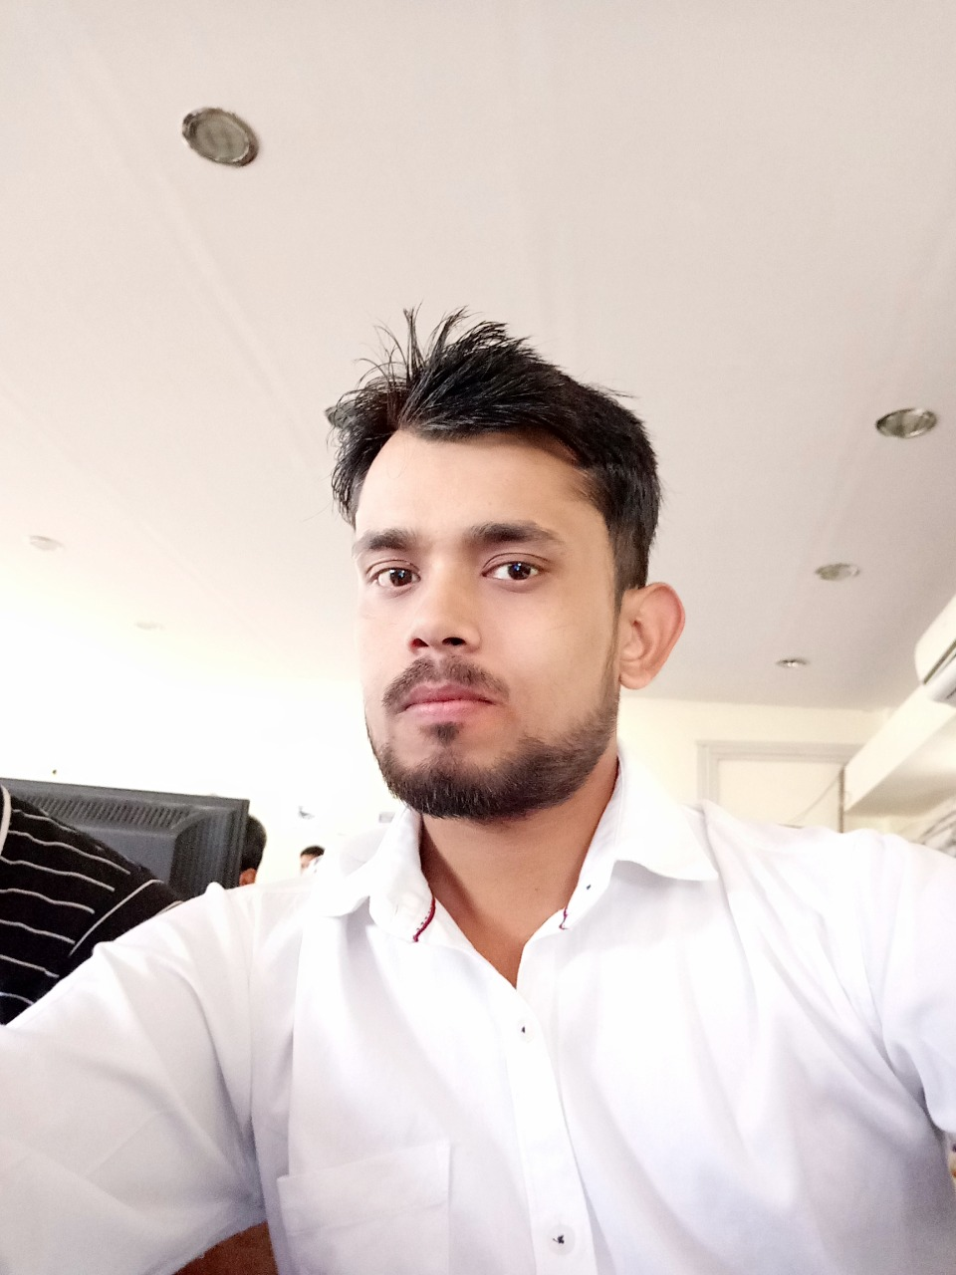
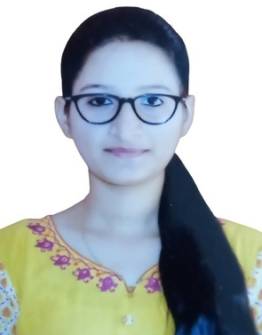
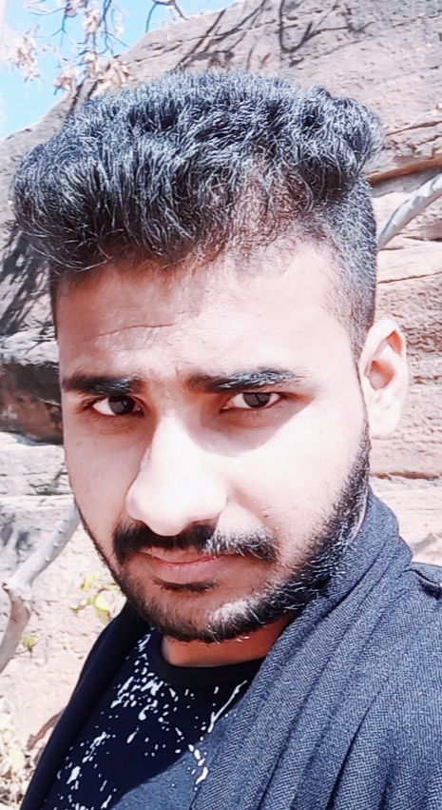
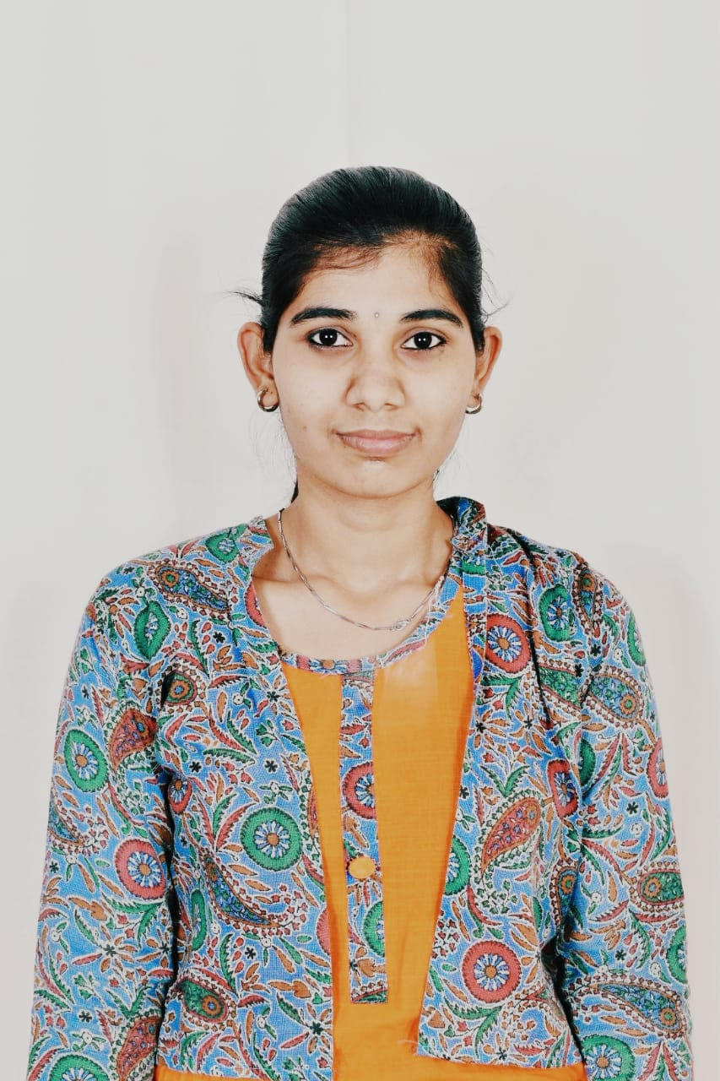
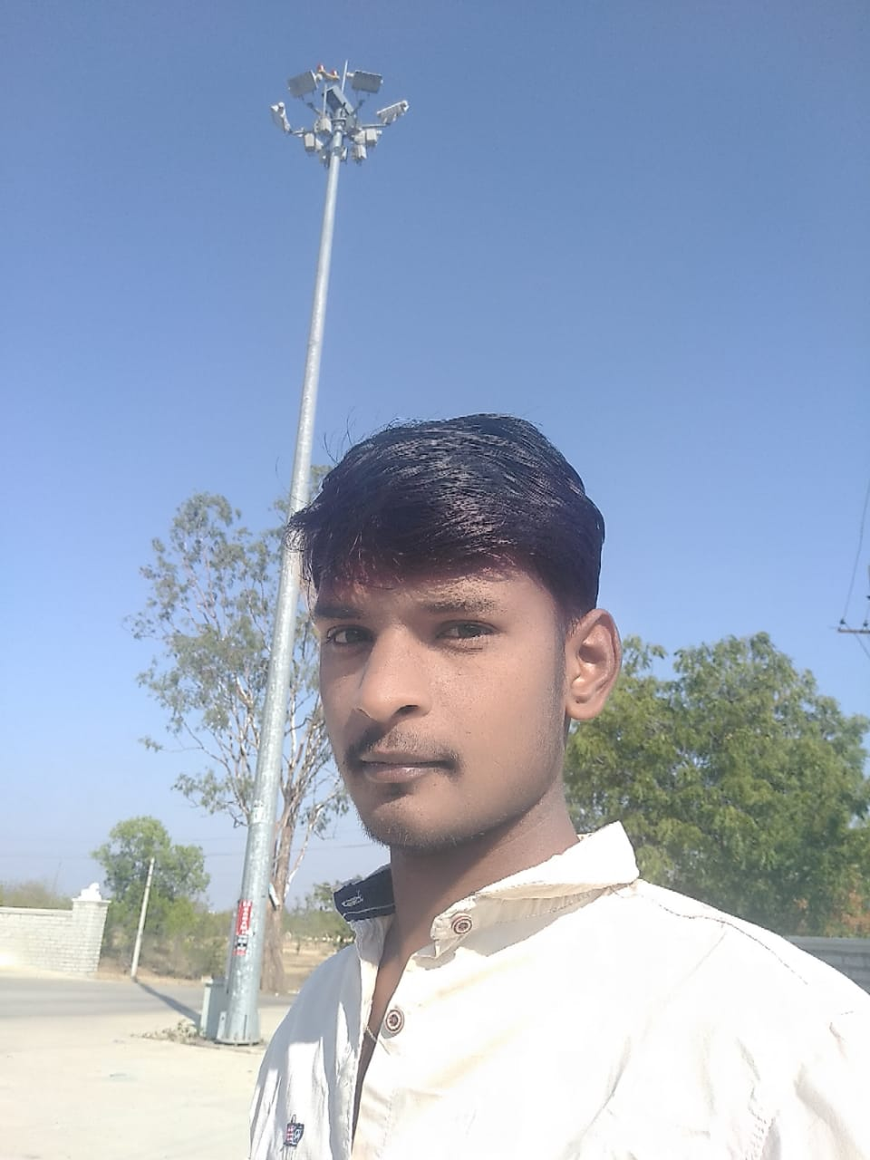
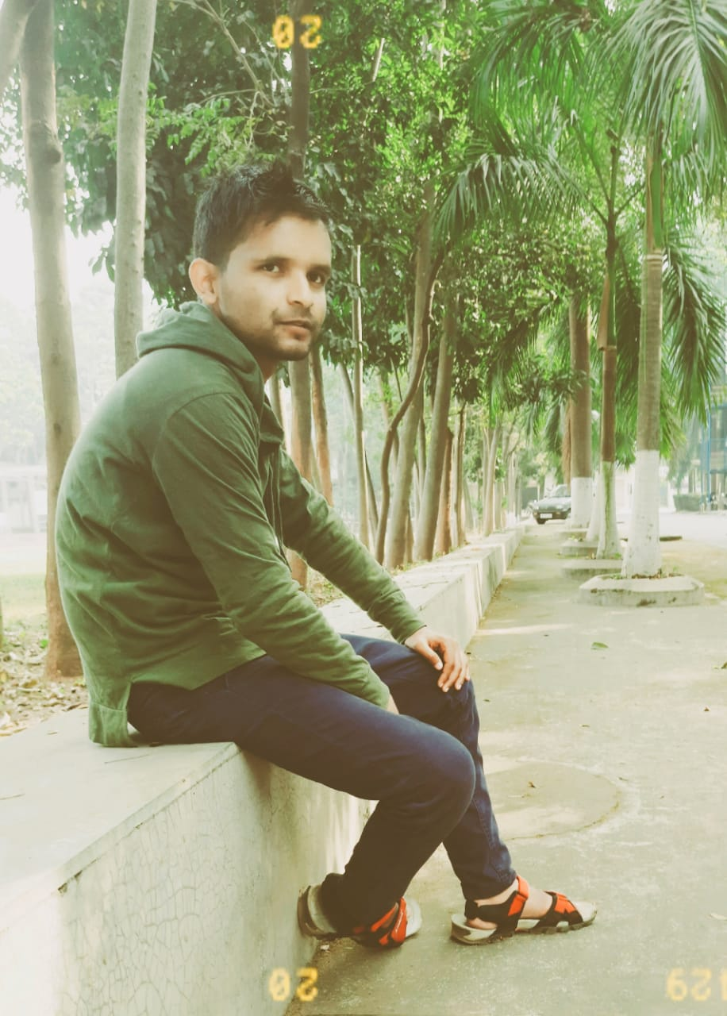
Team
members
ASHWINI RAMDAS KALSKAR
RITURAJ BHARTI
CHANDAN
ABHITOSH KUMAR
GORANTLA INDIRA
PRAVEEN KUMAR

Slide 53
References
Web Sites:-
www.tutorialpoint.com
www.w3schools.com
BOOKS:-
Database system concept by Henry Korth

